Slide 1
QUANTUM ADVANTAGES ON FACTORIZATION PROBLEM
Xingjain Wu, Hongjin Wang, Yiyang Zeng, Junlin Song

Slide 2
Abstract
Introduce four different methods of quantum factorization and their state-of-the-art results
Extend the ability of Grover’s algorithm on factorization to achieve factorization of the number 9975814637 with 2 qubits
Observe good agreement between experimental and theoretical results with high fidelity
Discuss the result, limitation of Grover’s algorithm and the impact of quantum factorization on encryption

Slide 3
Introduction
Public-key encryption: factorization (RSA)
Four main methods of factorization in quantum computing:
Shor’s algorithm
Grover’s algorithm
Adiabatic quantum computation
Quantum annealing
Best results:
Shor’s algorithm: 21
Adiabatic quantum computation: 551
Quantum annealing: 376289 (logical qubits)
Grover’s algorithm: 4088459 (real hardware!)

Slide 4
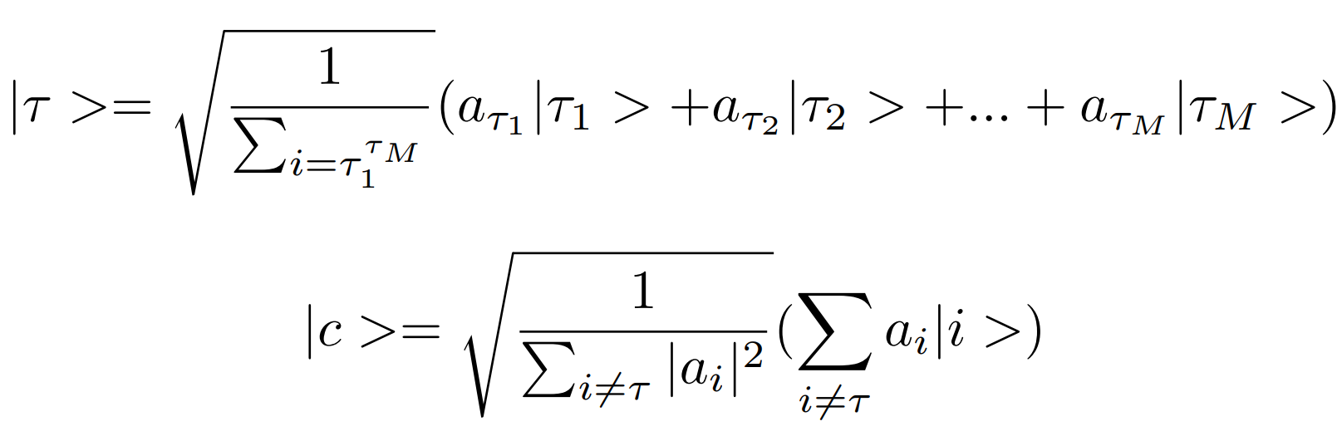
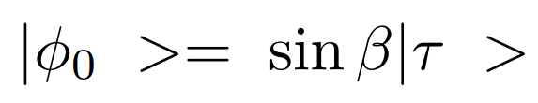

Generalized Grover’s algorithm
Searching M marked states from an arbitrary distributed N−item quantum database.
|τ > and |c > respectively represent the normalized state sum over all the marked states and all the non-marked states
Then we can express the database

Slide 5

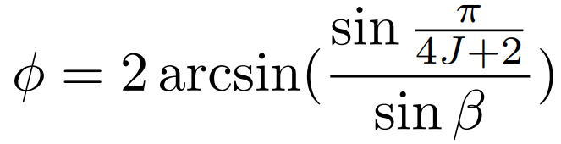




Generalized Grover’s algorithm
Perform a conditional shift to the M marked states.
Perform a n-qubit operation where U transforms |0> to
Perform a conditional shift to |0> and to all other states
Perform the n-qubit transformation U

Slide 6


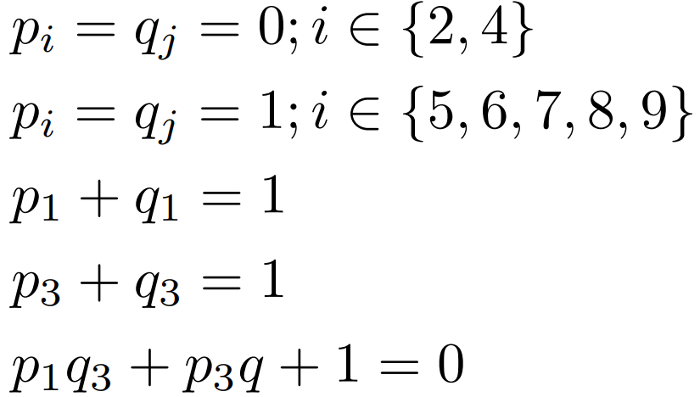

Factorization to searching
Factorize N = p × q
Binary representation
Case study: N = 4088459 = 2017×2027. (11111101011, 11111100001)

Slide 7

Results
We attempt to demonstrate the procedure to factorize number 9975814637. We solve this problem by translating it into Grover algorithm target, and apply a quantum circuit which only requires two qubits.
Certain limits should be applied onto the number we want to factorize. The prime number 9975814637 could be factorized into two large prime numbers 99877 and 99881. The binary value of 99877 is 11000011000100101, and the binary value of 99881 is 11000011000101001. They all have 17 digits of binary values and both starts and ends with 1. They have two digits different from each other, which are the third and the fourth digits: = 01 and = 10.

Slide 8
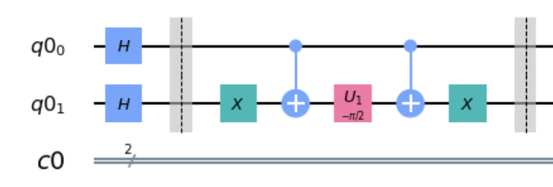


Circuit part 1
The two-digit difference informs that a two qubit Hamiltonian should be used to factorize N = 9975814637.
After the barrier line is the implementation for . The operation is expressed as the product of multiple unitary gates. Overall, the action of this part of the circuit is to conditionally introduces a phase shift of θ angle only to the ground states of instead of other basis states, that encodes solution into the oracular part. Hence, our required ”solution” states have been marked as required for the quantum search algorithm.

Slide 9
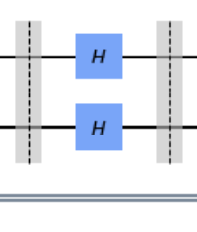


Circuit part 2
We apply the , which is the inverse operation of U such that , in order to compensate the previously required marking process that transformed qubits into 2-qubit equal superposition states.

Slide 10

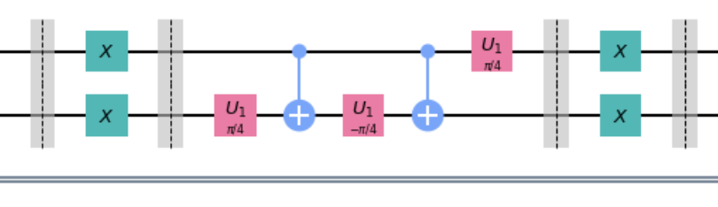
Circuit part 3
We implement to satisfy our amplitude amplification purpose that only targeted states would be applied phase shift , and leave other basis states unchanged.

Slide 11

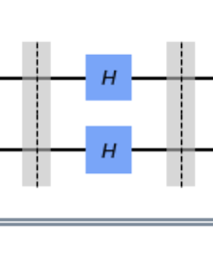
Circuit part 4
Finally, apply U to obtain an equal superposition of the marked states only. In this case, the value of θ must be .

Slide 12
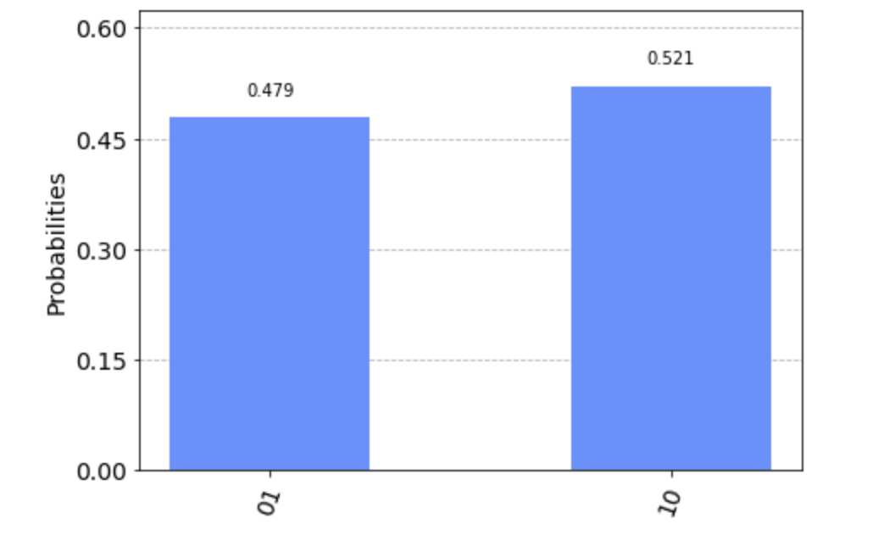
Simulator results
The figure below shows the result obtained from qasm simulator backend, with default 1024 shots.
bin(99877) = 11000011000100101
bin(99881) = 11000011000101001

Slide 13
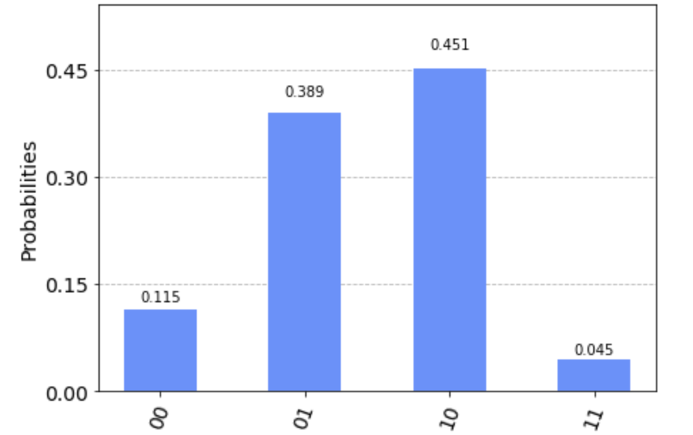
Real hardware results
The figure below presents the result obtained from real quantum computer with 8192 shots.
bin(99877) = 11000011000100101
bin(99881) = 11000011000101001

Slide 14
Discussion: Grover’s algorithm
Grover’s algorithm uses amplitude amplification to find the answer.
Essentially the answer is only needed to construct the oracle part of the circuit; the rest of the circuit is always the same.
No guaranteed that we may know the answer in constructing the oracle as an individual.

Slide 15
Discussion: Post-quantum security
It proves to ensure encryption in the context of quantum computers.
Post-quantum algorithms avoid acceleration brought by quantum algorithm.
It offers a solution to the problem of encryption in the presence of an emerging and promising field.

